Slide 1
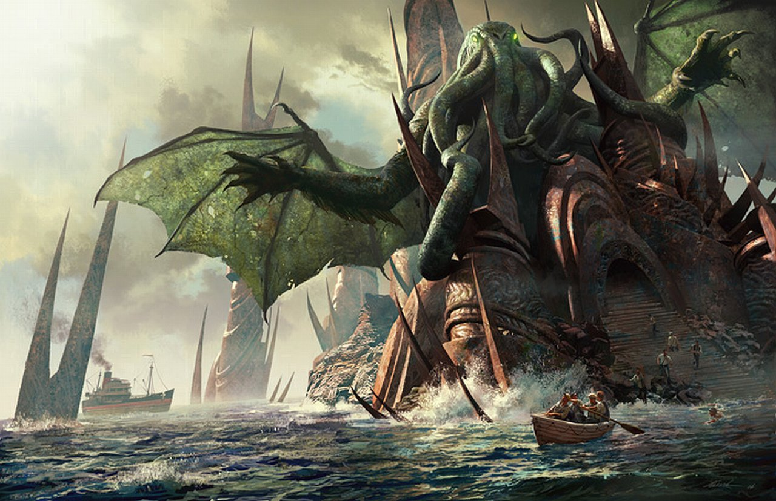
MONSTERS IN LITERATURE & FILM IAH 207: Literatures, Cultures, & Identities Dr. Joshua Lam
Fan’s Illustration of “The Call of Cthulhu,” by H.P. Lovecraft

Slide 2
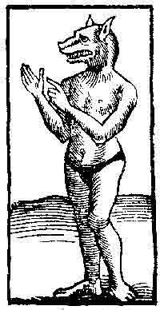
“He who fights with monsters should look to it that he himself does not become a monster. And when you gaze long into an abyss the abyss also gazes into you.” —Friedrich Nietzsche, Beyond Good and Evil
Werewolf Woodcut, Switzerland 1555

Slide 3
Today’s Class:
Introduction
Rules/Requests
Course Goals
Syllabus Review
Course Content
How to ‘Take’ this Class
Icebreaker
Read/Write/Share
Homework

Slide 4
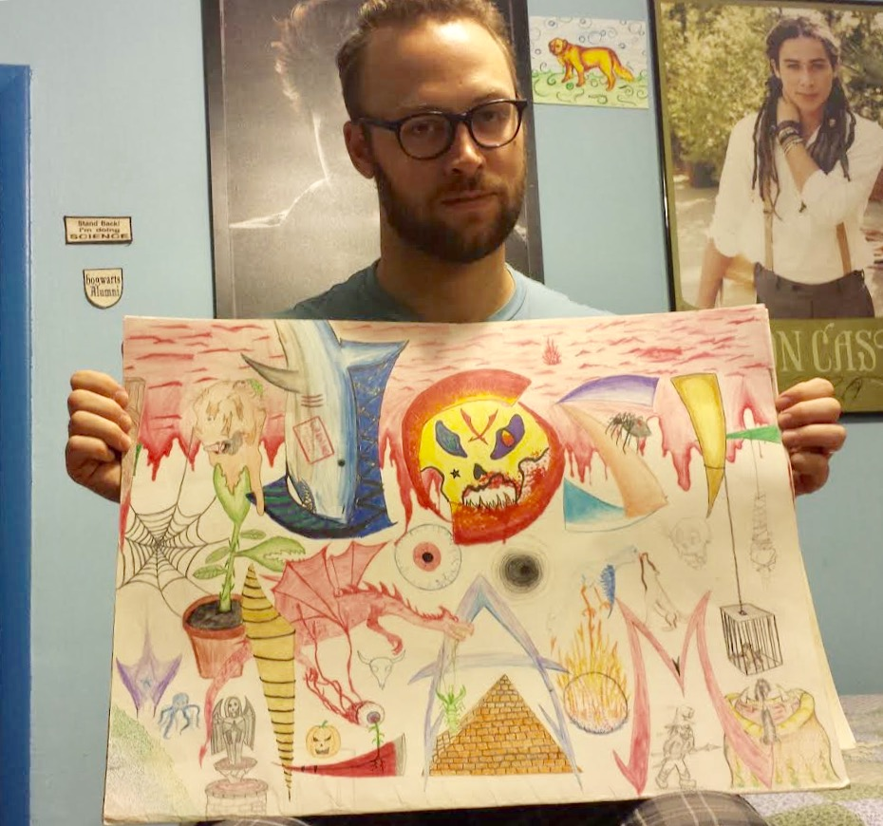
Your Professor
Joshua Lam, PhD

Slide 5
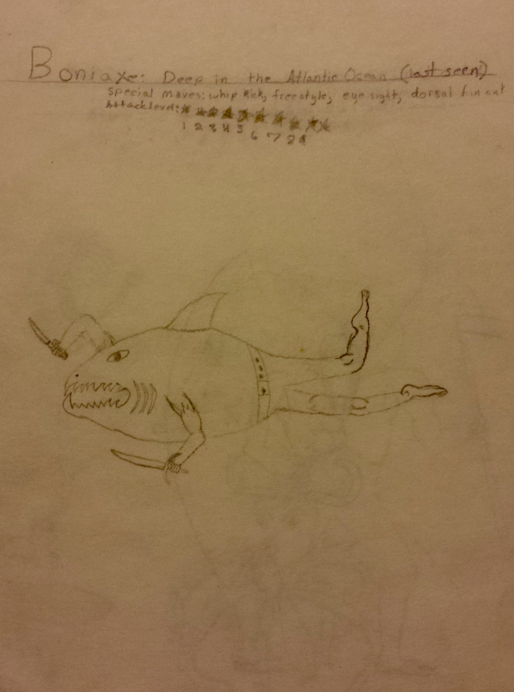
Your Professor
Age 10

Slide 6
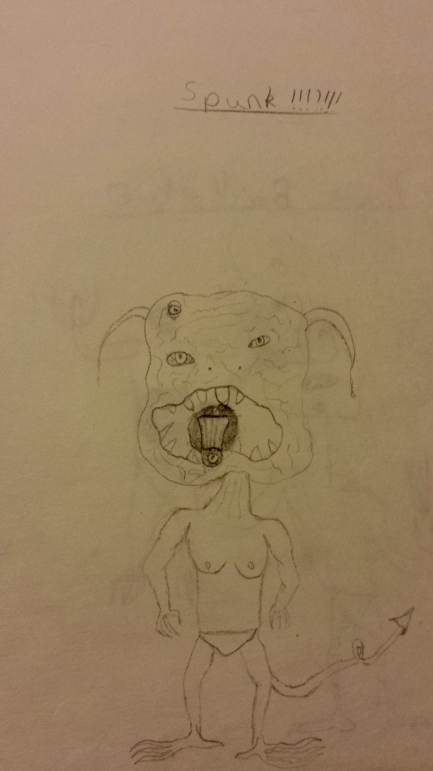
Your Professor
Age 12

Slide 7
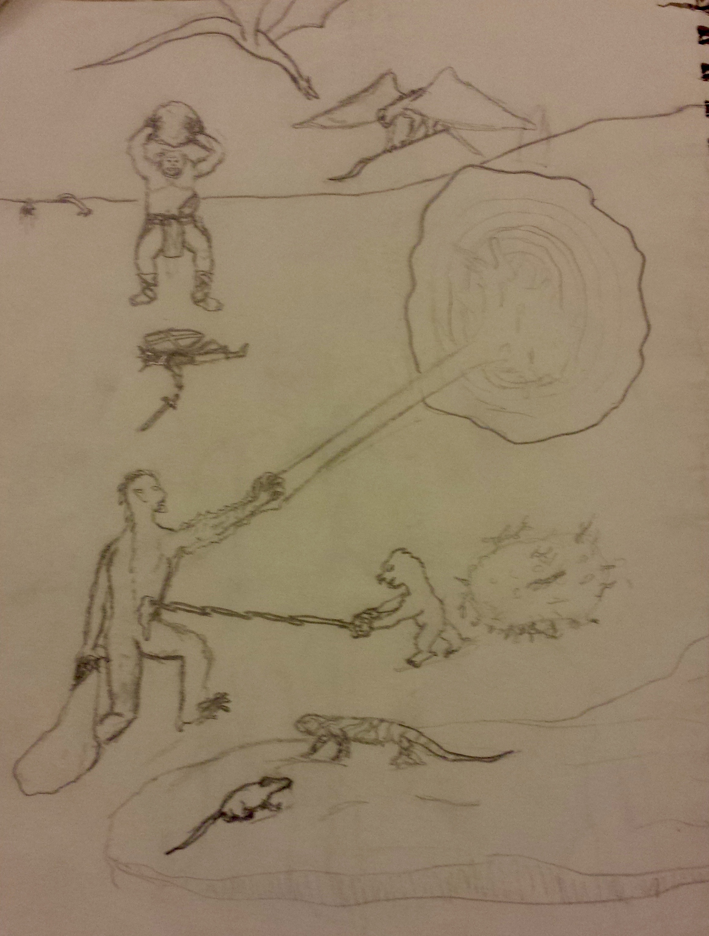
Your Professor
Age 14

Slide 8
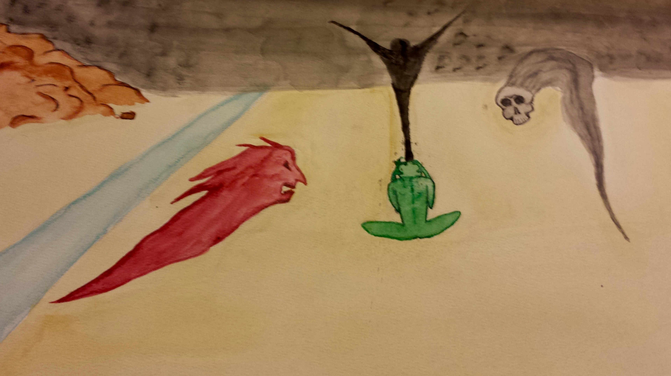
Your Professor
Age 16

Slide 9
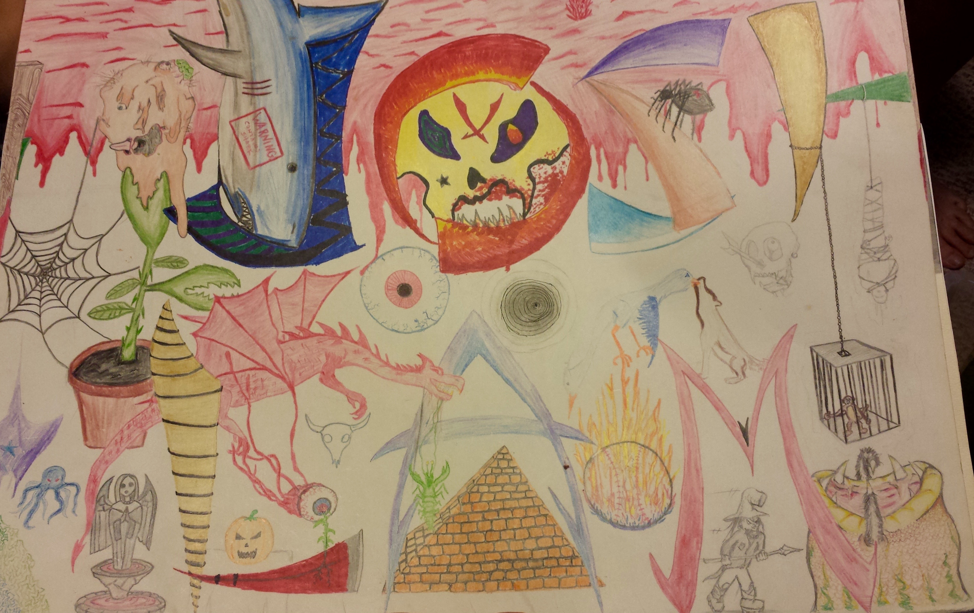
Your Professor (Age 17)

Slide 10
Course Goals
Explore the cultural significance of “monsters”
Practice literary and cultural analysis
Introduce literary and popular genres:
Horror
Science Fiction
Fantasy
Speculative Fiction
Fairy Tale
Gothic
Modernism
Postmodernism

Slide 11
Rules & Requests
Cell phones on silent, put away
Arrive on time
Please do NOT sit in last few rows
Drinks/food OK, but clean up after yourself ☺

Slide 12

Required Texts (5)
1. Angela Carter, The Bloody Chamber & Other Stories
(Penguin Classics Deluxe Edition, 2015)
Available at:
Spartan Bookstore (International Center)
Most bookstores
Amazon, Barnes & Noble, etc.
*Needed for next class*

Slide 13

Required Texts (5)
2. Franz Kafka, The Metamorphosis (1915)
Translated by Susan Bernofsky
(Norton, 2014)
Available at:
Spartan Bookstore (International Center)
Most bookstores
Amazon, Barnes & Noble, etc.

Slide 14
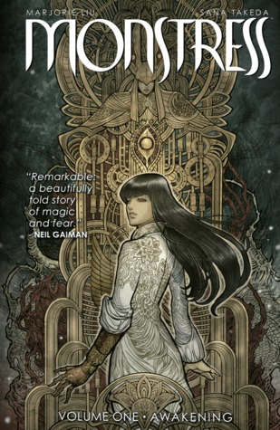
Required Texts (5)
3. Marjorie Liu, Monstress, Vol. 1: Awakening
(Image Comics, 2016)
Available at:
Spartan Bookstore (International Center)
www.imagecomics.com
Amazon, Barnes & Noble, etc.
Some comic shops or bookstores

Slide 15

Required Texts (5)
4. Octavia Butler, Fledgling (2005)
(Grand Central Publishing, 2007)
Available at:
Spartan Bookstore (International Center)
Some bookstores
Amazon, Barnes & Noble, etc.

Slide 16
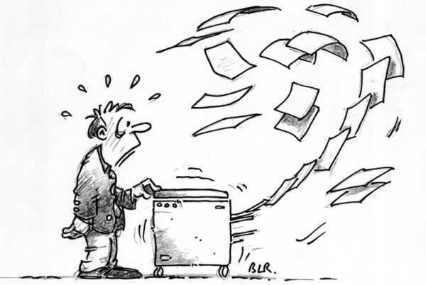
Required Texts (5)
5. IAH 207 COURSE PACK
(MSU Libraries)
*Only* Available at:
Spartan Bookstore (International Center)

Slide 17
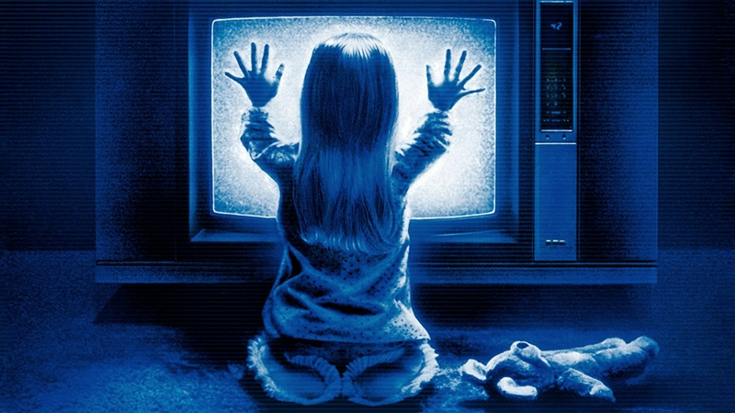
Required Films
NO IN-CLASS SCREENINGS
How to view Required Films:
Rent (or purchase) via iTunes or Amazon
Loan DVD from Course Reserve (Digital/Media Center, Main Library)
2 hr limit
Must be viewed at library

Slide 18
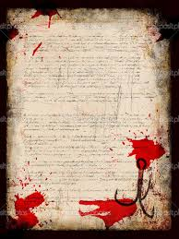
Syllabus Review
Assessment
Attendance/Participation 15%
Reading/Viewing Quizzes 10%
Mid-Term Project 50%
a) Group Project (25%)
b) Mid-Term Essay (25%)
Final Exam (Take-home essay) 25%

Slide 19
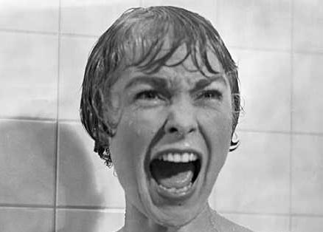
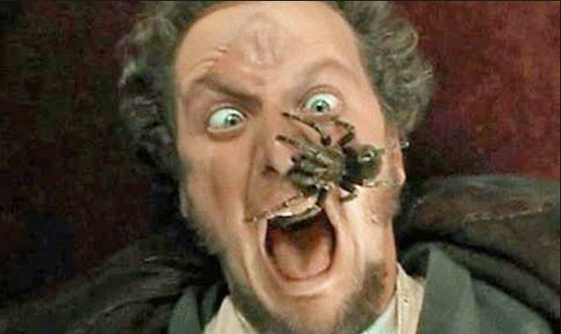
Syllabus Review
DISCLAIMER
Much of the required course content will include violence, sex, horror, and things that are just plain gross. If you don’t think you can handle it, or don’t want to, you may wish to consider a different course. Last day to drop with refund is Mon, Sept. 25.

Slide 20
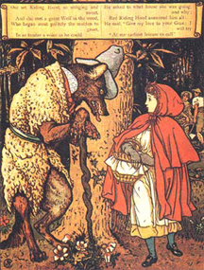
Course Content
Weeks 1-3
Fairy Tales by:
The Brothers Grimm
Charles Perrault
Angela Carter
Monsters:
Wolves
Werewolves
Beasts
Parents
Grandparents
Little Girls

Slide 21

Course Content
Week 4
Mary Shelley’s Frankenstein (dir. Branagh, 1994)
Excerpt from Mary Shelley, Frankenstein (1818)
Monsters:
Dr. Frankenstein
The “Creature”

Slide 22
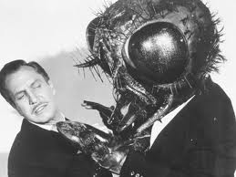
Course Content
Weeks 4-6
Giant insects in:
Franz Kafka, The Metamorphosis (1915)
The Fly (dir. Cronenberg, 1986)
Monsters:
Giant Bugs
Fly-Human Hybrids
Mad Scientists
Mutant Insects
Family Members

Slide 23

Course Content
Weeks 6-7
Aliens in:
Alien (dir. Scott, 1979)
H.P. Lovecraft, “The Call of Cthulhu” (1928)
Monsters:
Aliens
Gods
Scientists
Racists

Slide 24

Course Content
Week 8
Zombies in:
Night of the Living Dead (dir. Romero, 1968)
World War Z (dir. Forster, 2013)
W.B. Seabrook, The Magic Island
Junot Díaz, “Monstro”
Monsters:
ZOMBIES
ZOMBIES
SO MANY ZOMBIES

Slide 25
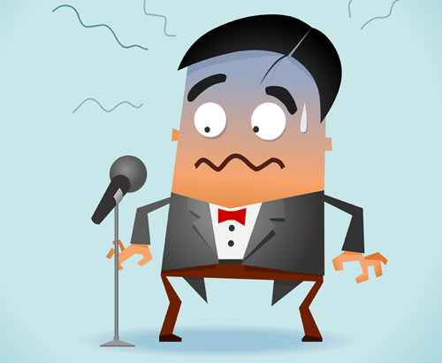
Course Content
Weeks 9-10
Students in:
Group Presentations
Monsters:
Inattentive Audience Members
Stage Fright

Slide 26

Course Content
Weeks 11-12
Vampires in:
Bram Stoker’s Dracula (dir. Coppola, 1992)
Excerpts from Bram Stoker, Dracula (1897)
Octavia Butler, Fledgling (2007)
Monsters:
Dracula
Vlad the Impaler
Vampires
Aliens?

Slide 27
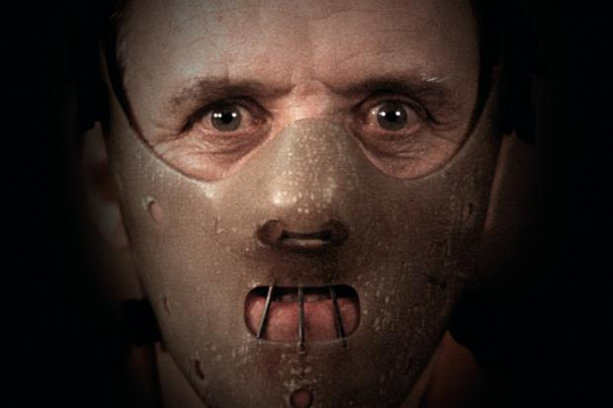
Course Content
Weeks 13-14
Serial Killers in:
The Silence of the Lambs
(dir. Demme, 1991)
Bret Easton Ellis, American Psycho
Monsters:
Serial killers
Psychiatrists
Bureaucrats
Yuppies

Slide 28
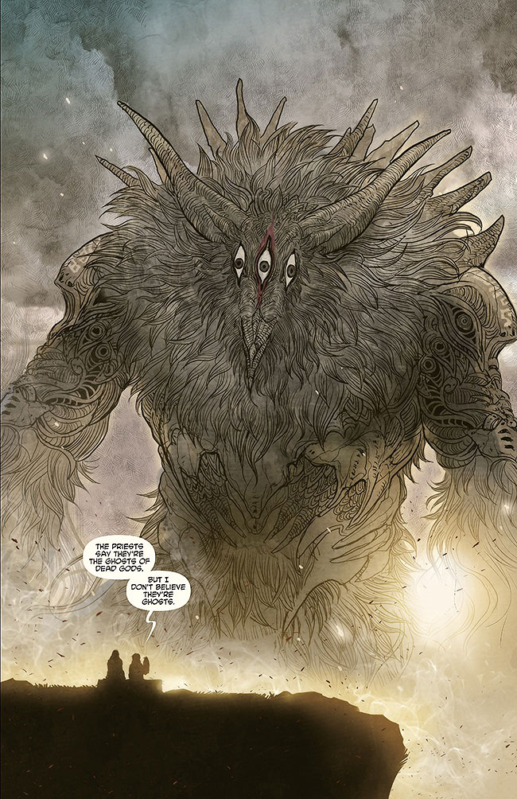
Course Content
Ghosts, Elder Gods, and Unnamed Evils in:
Maxine Hong Kingston, The Woman Warrior (1975)
Marjorie Liu & Sana Takeda, Monstress (2016)
Monsters:
Ghosts
Dead Children
Dead Aunts
Husbands
War
History
Patriarchy

Slide 29

Course Content
Week 15
Aliens in:
District 9 (dir. Blomkamp, 2009)
Monsters:
Aliens
Prawns
Cyborgs
Humans

Slide 30
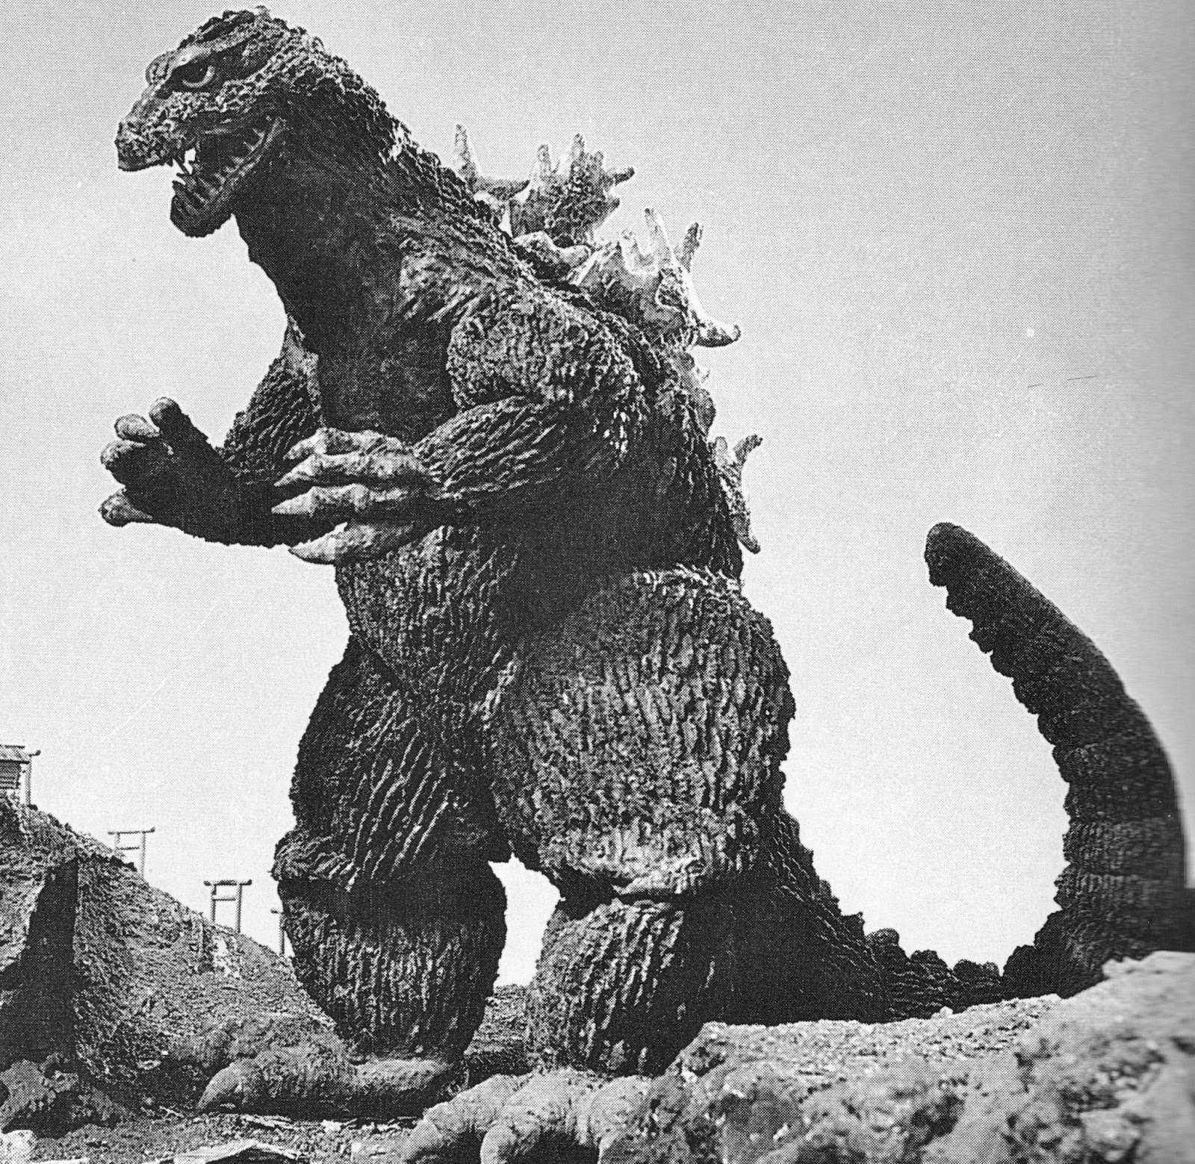
Course Content
Week 15
Godzilla in…
Gojira (dir. Honda, 1954)
Monsters:
Godzilla…
…do you even need any other monsters?

Slide 31
Course Questions
Why do we enjoy being frightened? Repulsed?
What can monsters teach us about different cultures?
What roles to monsters play in literature? In film? In different genres?
Who and what are monsters?
What are the politics of identifying, naming, calling someone or something a ‘monster’?

Slide 32
How to ‘Take’ This Class
Attend Classes
Lecture slides will be made available after the fact
Slides are NOT a substitute for attending lectures
Take Notes
As you read/view
During lectures
During/after discussion
Read/View Material Before Class
Peer Interaction
Ask Questions
Revisit/Review notes, signal questions, materials

Slide 33
A Typical Class Will Include
Lectures (10-15 minute segments)
In-Class Writing/Reflection
Peer Discussion
Group Discussion (whole class)
“Signal Questions”
Brief film clips

Slide 34
Exam May Include
Lots of WRITING and ANALYSIS
Short Answer
Brief Essay(s) (~750 words)
Passage Recognition

Slide 35
Exam Evaluation
Exam will assess
Understanding of concepts
Familiarity with required texts/films
Understanding of genres, terms, ideas
Ability to interpret and analyze
Clarity of ideas/expression
Original/novel/creative thought will be rewarded

Slide 36

Mid-Term Project
The Group Project
Select a monster
Form groups of
Researchers
Writers
Artists
Presenters
Create and Present a Group Project to the class

Slide 37
Mid-Term Project
Group Project will assess
Collaboration
Delegation/sharing of work
Critical and creative thinking
Research, writing, design, and presentation skills
Ability to share what you’ve learned

Slide 38
Course Technology
On D2L, you will find:
Links to Required Readings not in Course Pack
Reading/Study Questions to help prepare for class
Links to supplementary material (not required)
Lecture slides (after the fact)

Slide 39
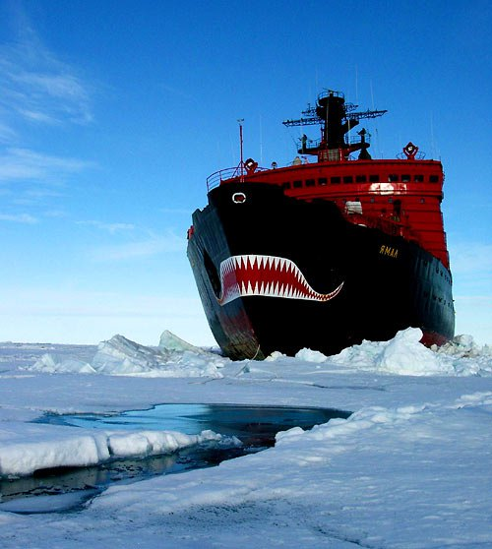
ICE BREAKER

Slide 40
Ice Breaker
Think of one “monster” or creature that scared you as a child.
Share this with the 2-3 classmates sitting closest to you.
As a group, decide: which one is scariest? Why?
Share with the class.

Slide 41
“He who fights with monsters should look to it that he himself does not become a monster. And when you gaze long into an abyss the abyss also gazes into you.” —Friedrich Nietzsche, Beyond Good and Evil
Re-Read:
Reflect, Write:
What is the author trying to say? What does this passage convey to you? What ‘monsters’ might Nietzsche be referring to? Does it remind you of anything (movies, books, comics, ideas, concepts, games)?

Slide 42
Share:
Turn to your classmates sitting nearby. Share your interpretations of the quotation with one another. Ask each other questions; try to convince one another of your interpretations.

Slide 43
Homework Reminder
Reading:
Brothers Grimm, “Little Red Cap” [4pp]
Angela Carter, “The Werewolf” [2pp]
Angela Carter, “The Company of Wolves” [9pp]
Purchase Required Texts

